Slide 1
TOWARDS AN ONTOLOGY-DRIVEN BLOCKCHAIN DESIGN FOR SUPPLY CHAIN PROVENANCE
TEAM MEMBERS:
YATANVESH BHARADWAJ 1NT17IS203
ABHRAJYOTI PAL 1NT17IS119

Slide 2
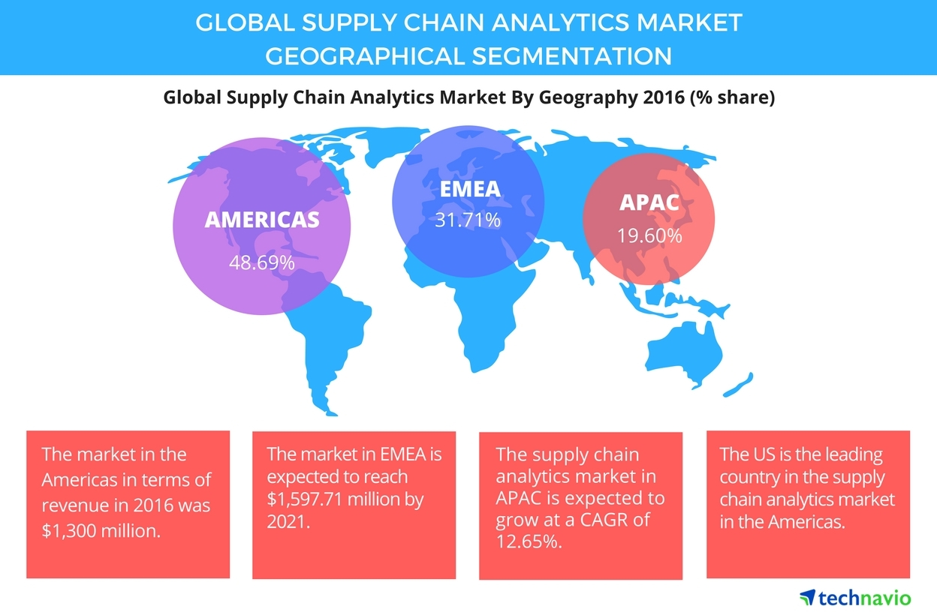
THE SUPPLY CHAIN INDUSTRY
According to market research by IndustryARC, the supply chain market is expected to reach 424.24 USD by 2023 with CAGR of 48.37%.
Large number of companies have been using blockchain technology for supply chain applications.

Slide 3
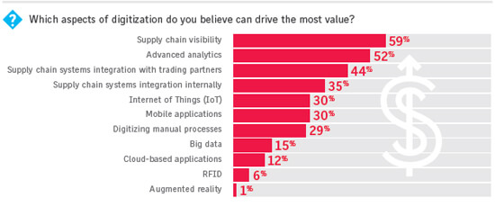
North America has a major share in Blockchain for Supply Chain
In Asia Pacific, the market is expected to have a CAGR of 56.1%.
In other economies like Middle East, Africa and Brazil, the increasing demand for digitization is due to government initiatives through foreign investment.
Ocean freight accounts for roughly 90% of goods traded globally

Slide 4
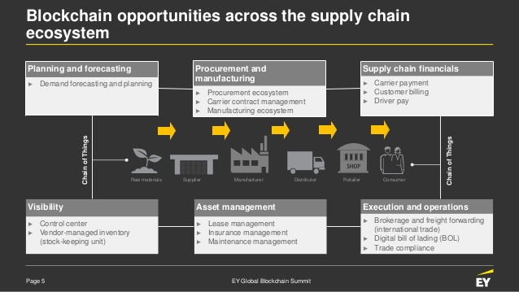
PROBLEMS WITH SUPPLY CHAIN
Difficult for Small Businesses
Manufacturers prefer large companies as customers
Opaque Procurement Process
Current manufacturing lacks accessibility to the procurement process.
Outdated Technology
Current technology and manufacturing processes are outdated.
Little to No IP Protection
Businesses lack intellectual property protection.

Slide 5
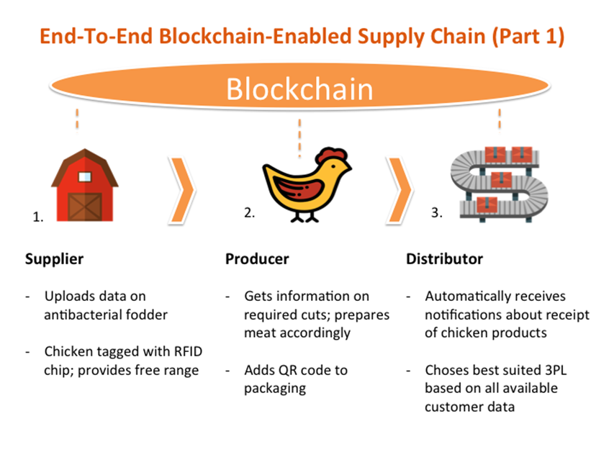
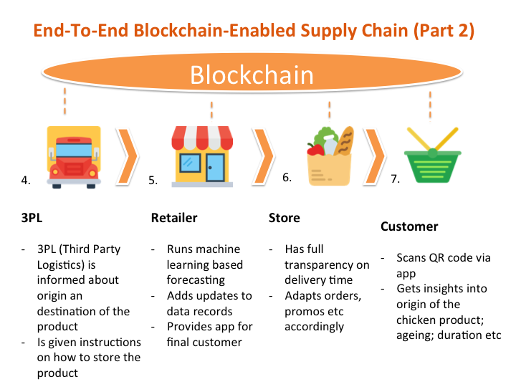
BLOCKCHAIN FOR SUPPLY CHAIN MANAGEMENT
A supply chain blockchain could boost transparency, trust and predictability allowing users to track where a system is at any given time
Changes in ownership of goods as they move from producer to retailer could be entered into ledger permanently.
Dispute resolution rules could be agreed upon beforehand and applied instantly to blockchain when necessary.
Business can gain visibility to their entire networks, from suppliers to the customers.

Slide 6
WHAT IS AN ONTOLOGY? WHY USE ONTOLOGIES FOR BLOCKCHAIN DEVELOPMENT?
Ontology deals with questions about what things exist or can be said to exist, and how such entities can be grouped according to similarities and differences, and the relations between said entities.
In ontology-based enterprise modeling, the conceptualization is the set of ontologies required to ensure common interpretation of data from one or more enterprises’ shared databases.
Ontology based blockchain modelling is based on the following assumptions:
A modeling approach based on informal or semi-formal ontologies can lead to better data standards, and business practices and processes for developing and operating a blockchain.
A modeling approach based on formal ontologies can aid in the formal specifications for automated inference and verification in the operation of a blockchain.

Slide 7
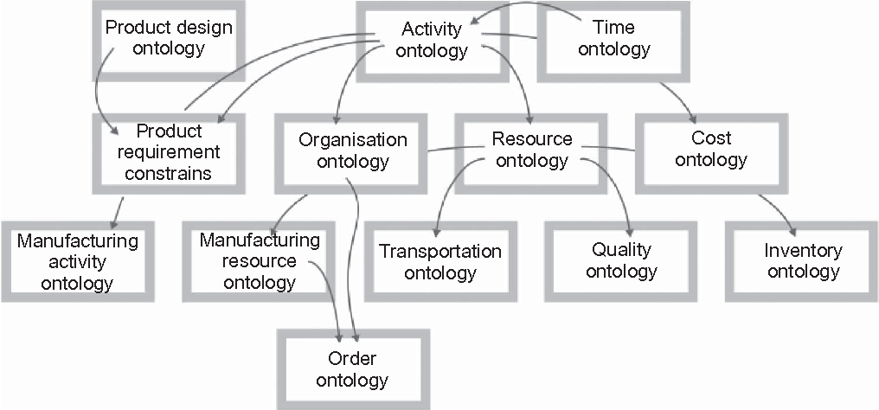
TOVE ONTOLOGIES
The TOVE project, acronym if Toronto Virtual Enterprise project is a project to develop an ontological framework for enterprise integration based on an suited for enterprise modelling.
The original goal of the project was fourfold:
Create a shared representation of the enterprise that each agent can understand.
Define the meaning of each semantics.
Implement the set of axioms.
Define a symbology for depicting a concept in graphical context.

Slide 8
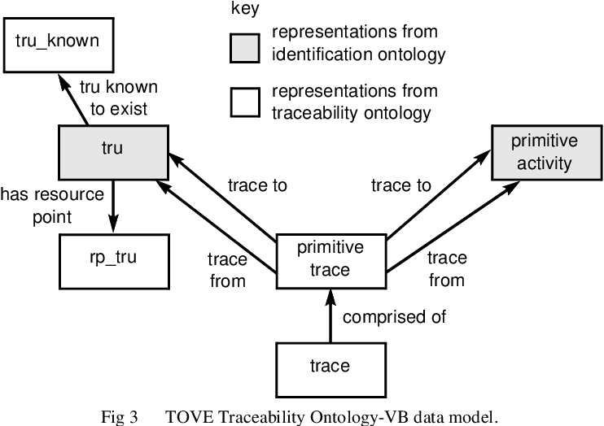
TRACEABILITY ONTOLOGY BASED BLOCKCHAIN FOR PROVENANCE
Key Informal Assumptions used in developing this ontology:
It must be possible to trace from one entity to another where the entities are abstracted entities.
Traceable Resource Unit is the resource representation that must be traceable, since it is neither an abstracted nor aggregated entity.
Primitive activity is the activity representation that must be traceable, since primitive activity is neither an abstracted nor aggregated entity.

Slide 9
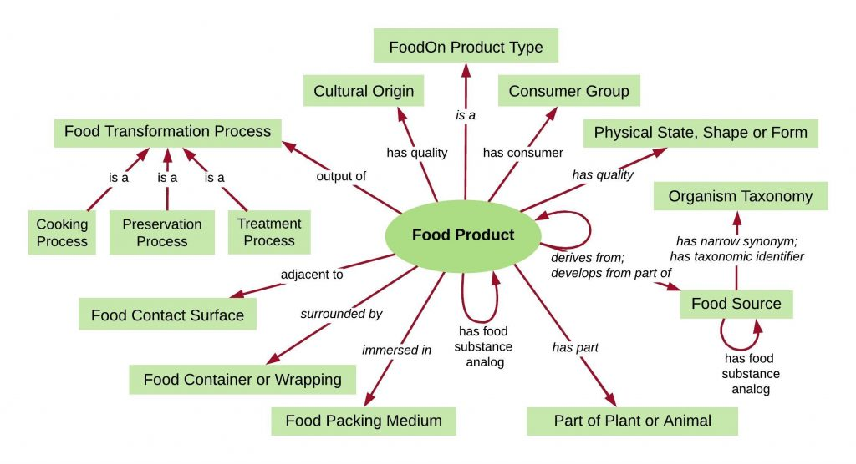
FoodOn: A food ontology

Slide 10
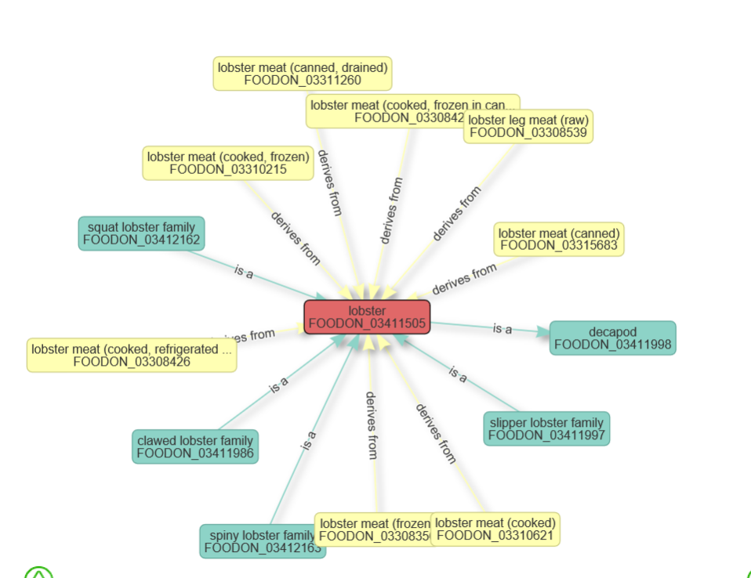
Lobster Ontology
https://www.ebi.ac.uk/ols/ontologies/foodon/terms?iri=http%3A%2F%2Fpurl.obolibrary.org%2Fobo%2FFOODON_03411505

Slide 11

https://www.provenance.org/explore

Slide 12

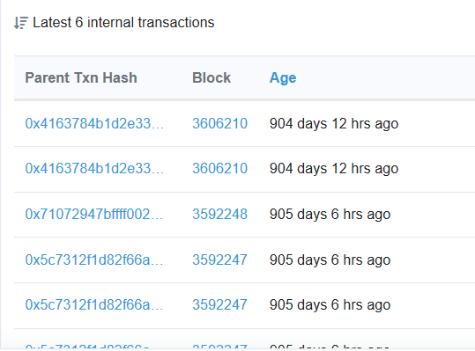
Provenance.org Example Asset
Asset Page: https://www.provenance.org/assets/0x05e3fbedab9efcf8488632988dda93af8b1a8590
Asset on blockchain: https://kovan.etherscan.io/address/0x05e3fbedab9efcf8488632988dda93af8b1a8590#internaltx

Slide 13
Implementation
Ontology based blockchain modelling assumption #2:
A modeling approach based on formal ontologies can aid in the formal specifications for automated inference and verification in the operation of a blockchain.
Ethereum smart contracts definition:
“pieces of software that represent a business arrangement and
execute themselves automatically under pre-determined circumstances.”
A modelling approach based on formal ontologies can aid in
the development of smart contracts that execute on the blockchain.

Slide 14
TRACEABILITY ONTOLOGY BASED BLOCKCHAIN FOR PROVENANCE
Key Informal Assumptions used in developing this ontology:
It must be possible to trace from one entity to another where the entities are abstracted entities.
Traceable Resource Unit is the resource representation that must be traceable, since it is neither an abstracted nor aggregated entity.
Primitive activity is the activity representation that must be traceable, since primitive activity is neither an abstracted nor aggregated entity.

Slide 15
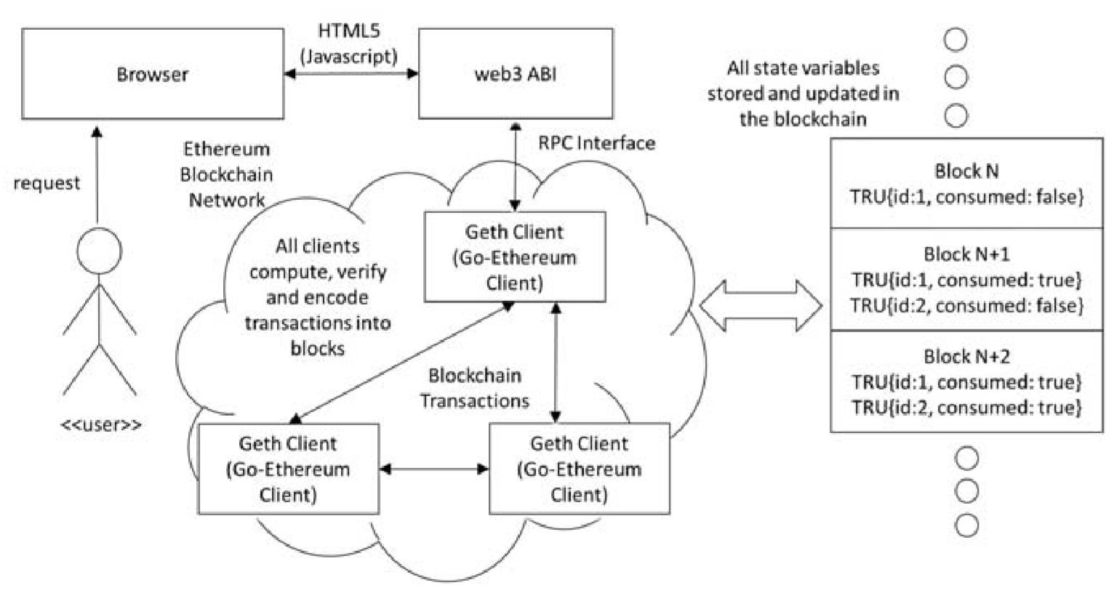

Slide 16
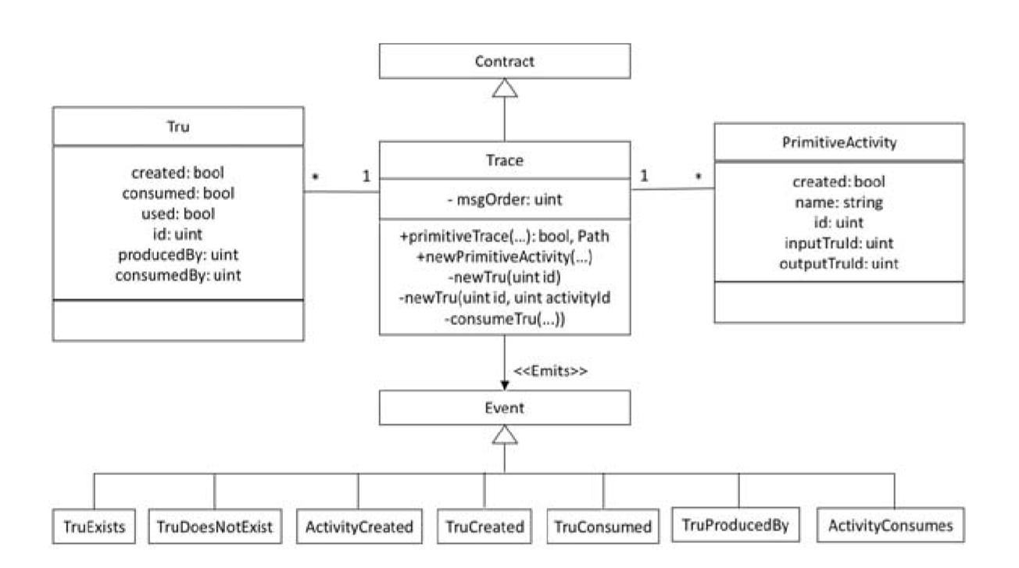

Slide 17
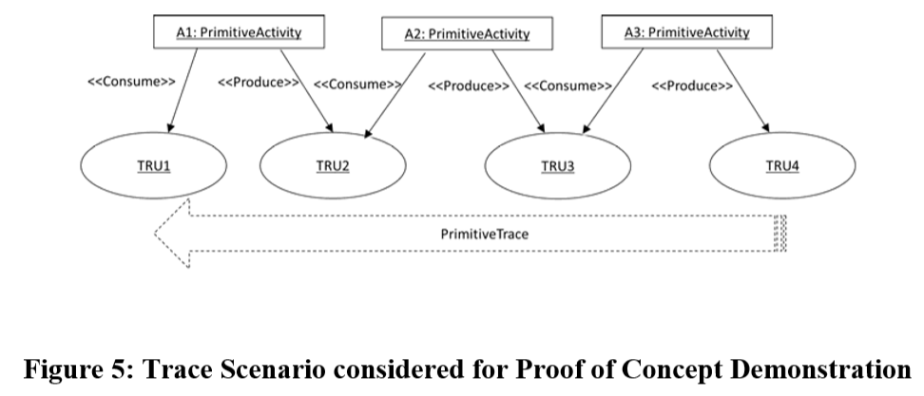
Primitive Trace

Slide 18
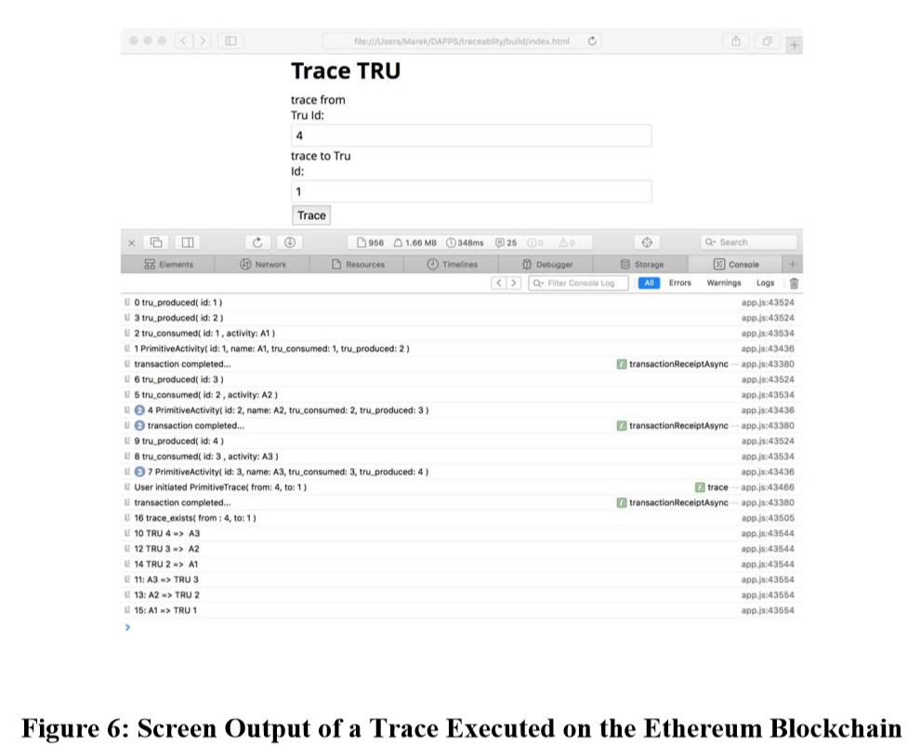

Slide 19


Slide 20
Takeaways
Importance of combining ontology with provenance tracking – enforces standards
The difficulties involved in coming up with ontologies which are agreed upon by organisations, but once done can lead to better data standards.
Historically - Supply chain provenance has generally been more difficult goods are handled in international supply chains where granular tracking of physical characteristics and product whereabouts had not been possible. Ontology + Provenance tracking solves this problem.
A proof of concept based on TOVE ontology has been implemented in solidity on Ethereum platform using primitives known as TRU and PRIMITIVE ACTIVITY, allows TRACE.

Slide 21
Thank you

